Slide 1
Waves & Wonders
By team-Web Wizards

Slide 2
Team Members:-
Member-1:- Ch.Satwik Reg-no:-22B91A6138
Member-2:-A-Rakshan Kumar Reg-no:-22B91A6107
Member-3:- B.Ganesh Reg-no:-22B91A6132
Member-4:- Ch.Satwik Reg-no:-22B91A6142

Slide 3

Introduction:
Waves and Wonders showcases breathtaking coastal landscapes, offering thrilling water activities, serene beaches, and unforgettable natural beauty for tourists.

Slide 4
Abstract:-
A beach tourism website provides comprehensive information about popular coastal destinations, offering visitors detailed insights on attractions, accommodations, activities, and local culture. It aims to enhance the travel experience by showcasing pristine beaches, water sports, and unique natural landscapes. Through interactive features like booking systems, itineraries, and travel tips, the website serves as a one-stop platform for beach enthusiasts. Additionally, it highlights sustainability efforts and eco-friendly practices, ensuring that visitors can enjoy a responsible and memorable beach vacation.

Slide 5
Objectives:-
Promote Coastal Tourism
Enhance Visitor Experience
Support Sustainability
Boost Local Economy

Slide 6
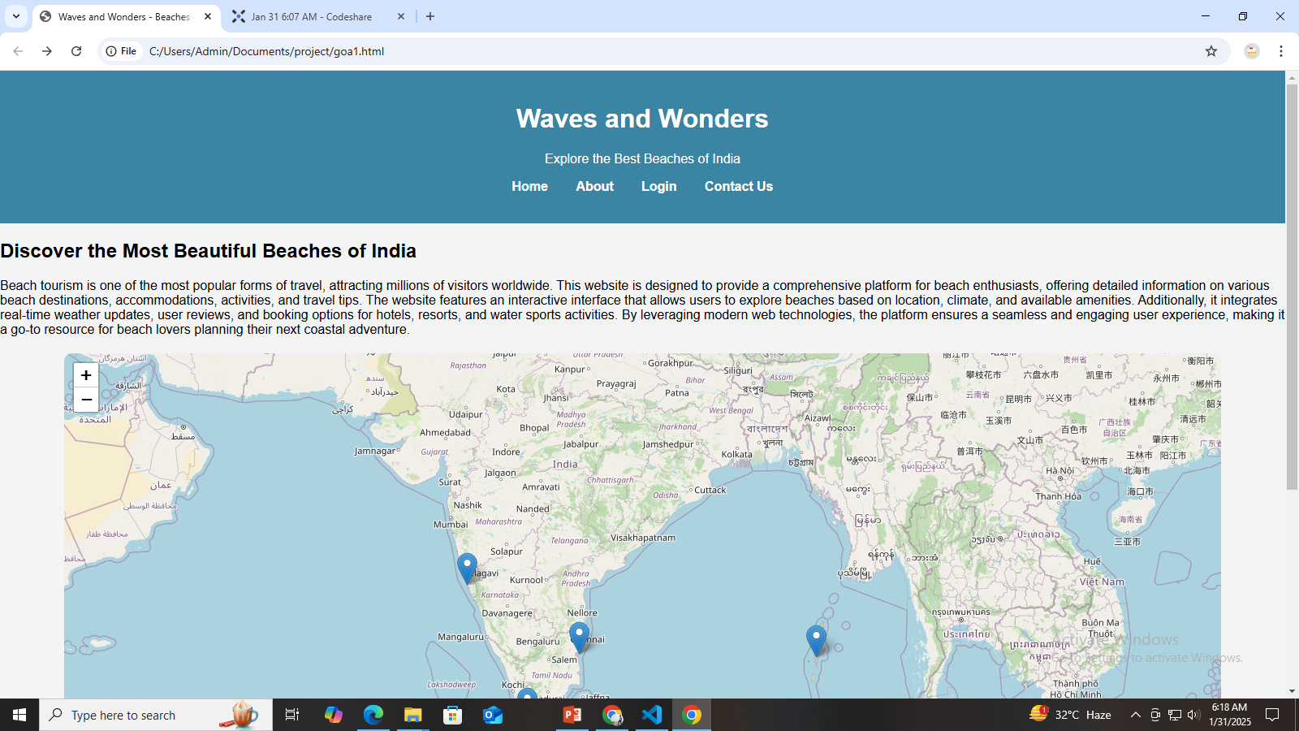
Home Page:-

Slide 7
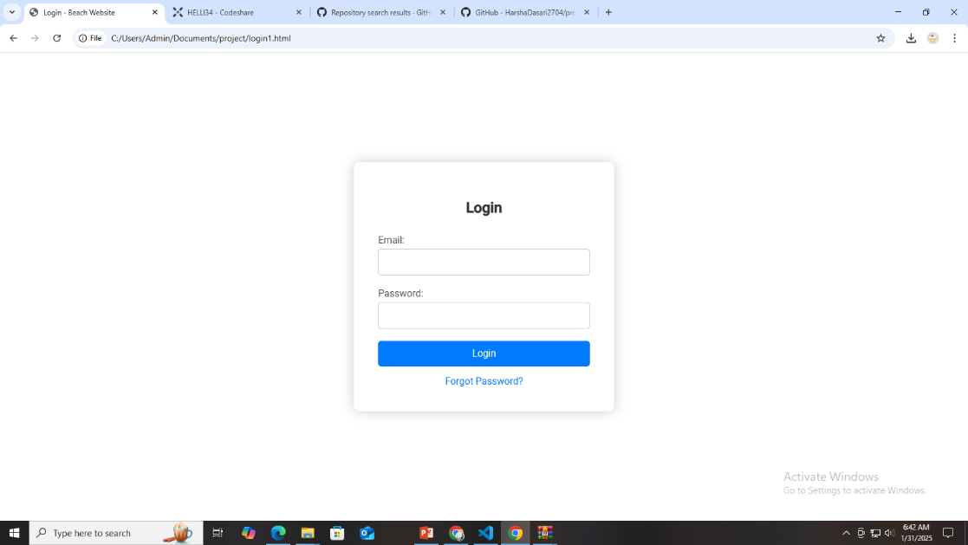
Login Page:-

Slide 8
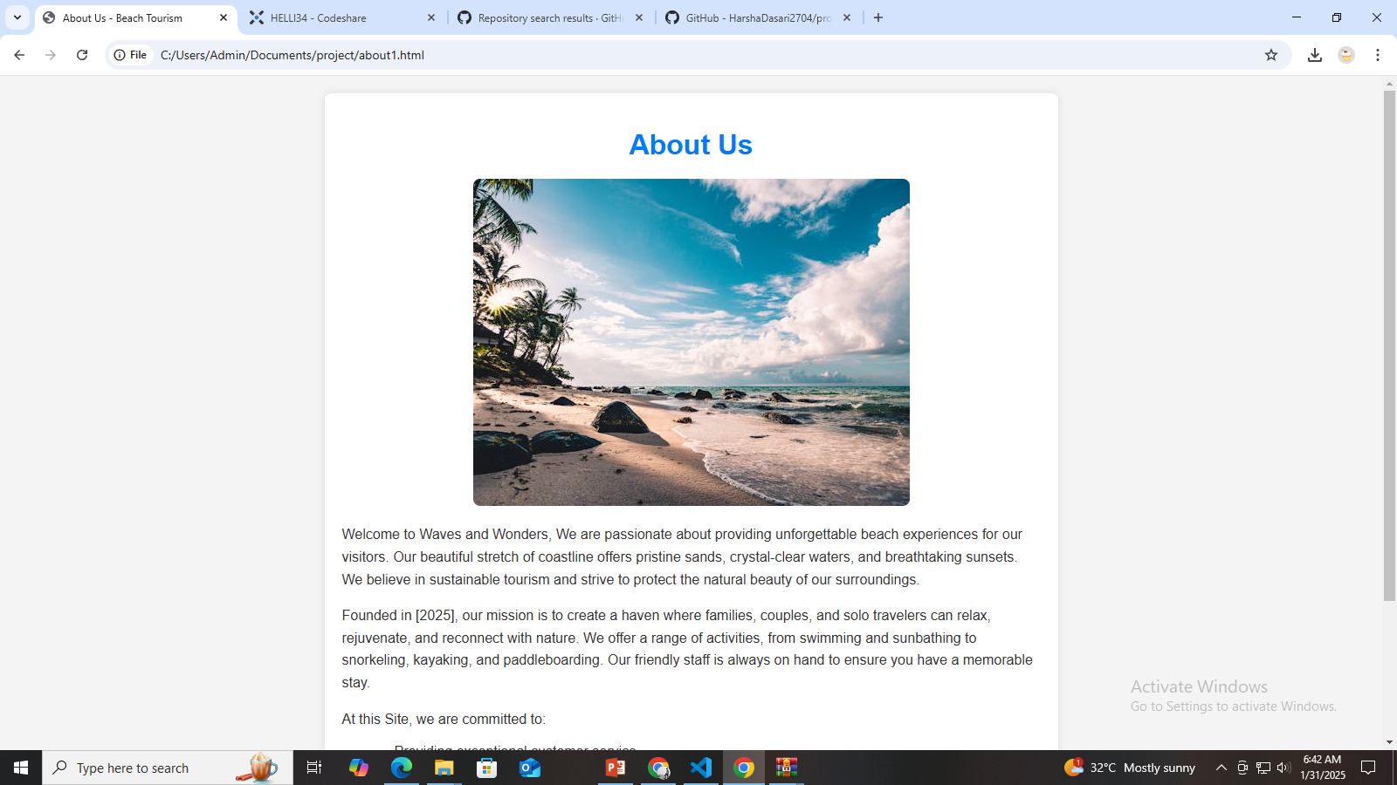
About Page:-

Slide 9
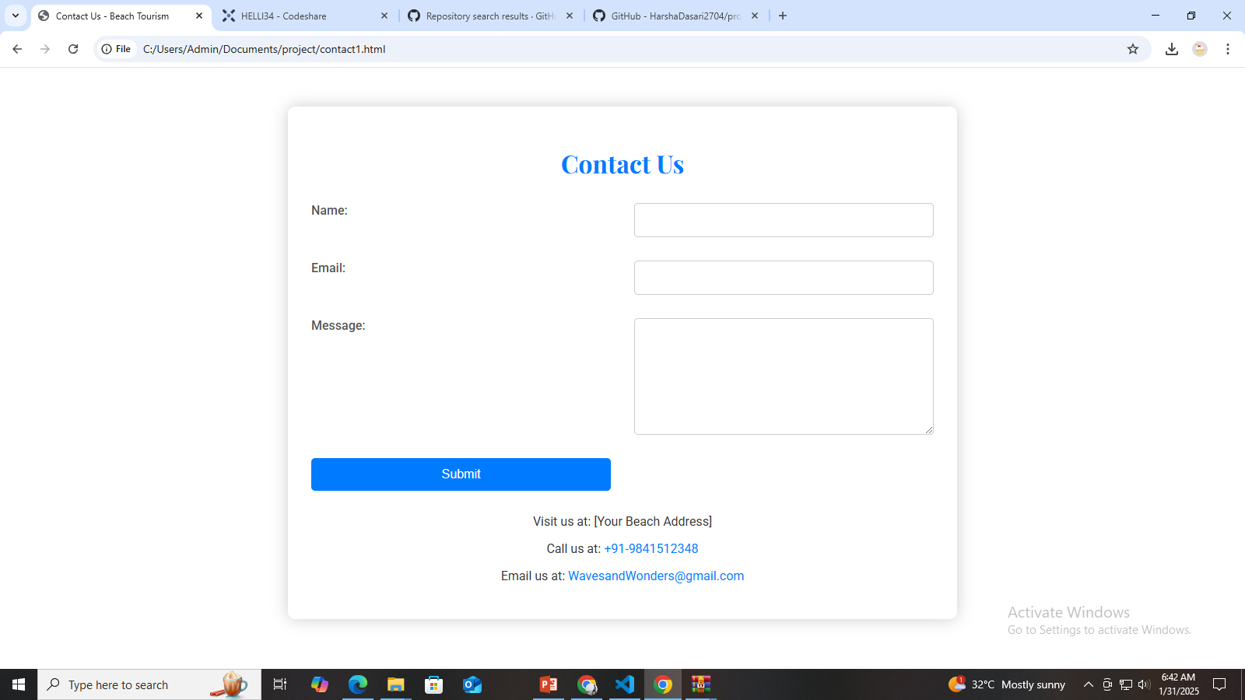
Contact Us:-

Slide 10
Git Hub Link:-
web-wizards:-https://github.com/ganesh04062003/web-wizards

Slide 11


